Slide 1
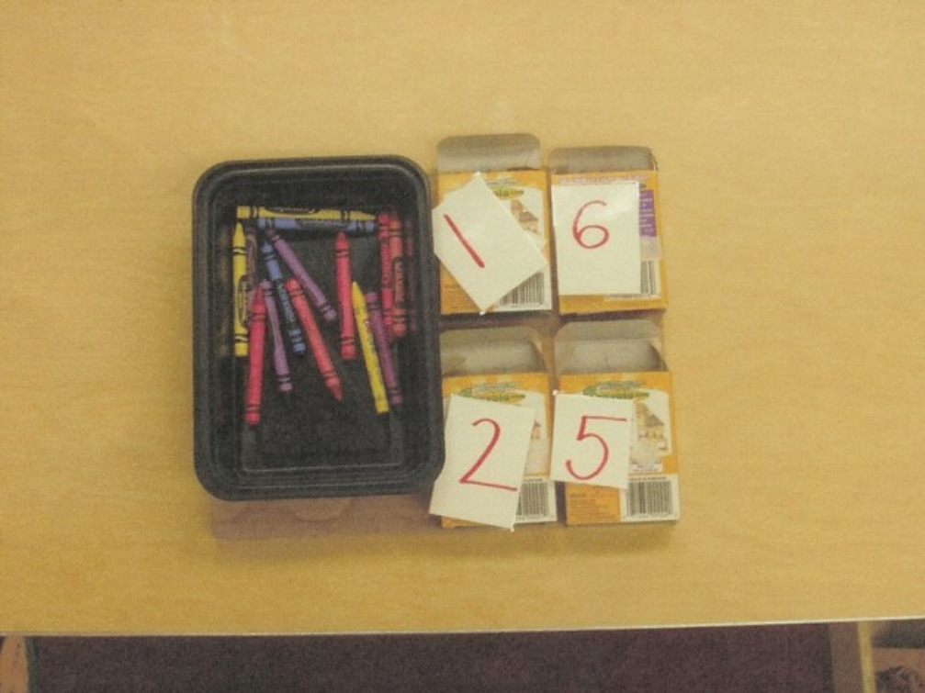
How to Make a Task

Slide 2
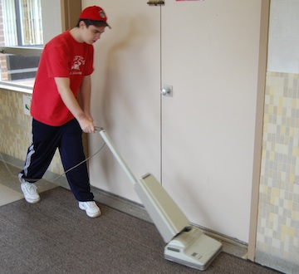
First: Use assessment results to determine need
After Task: Provide opportunities for generalization of the skill learned
We will demonstrate how to make tasks:
Choosing an IEP goal to work on
Using a grade level standard
Task analyzing an identified life skill

Slide 3
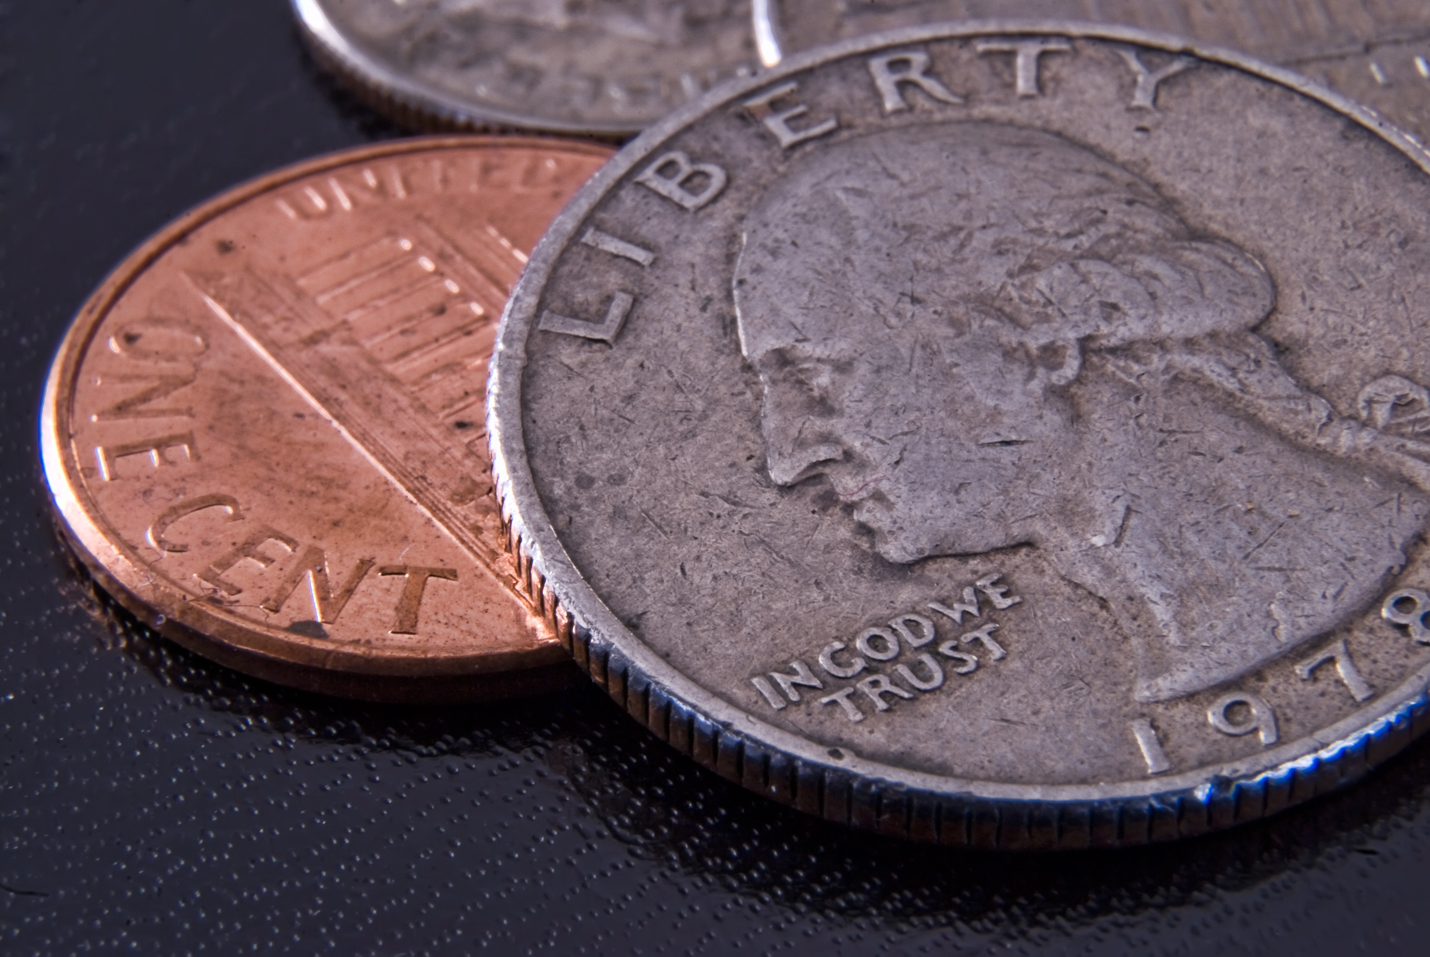
Steps for Making a Task for an IEP Goal
Choose the goal: Christina will independently count equivalent coin amounts up to $1.00 with 8/10 correct three times a week.
Think of different ways for the student to work towards the goal:
  Count actual coins to match an amount
  Match pictures of equivalent coin amounts
  Complete math computer tasks that match equivalent coin amounts
  Count out coins for vending machine use

Slide 4
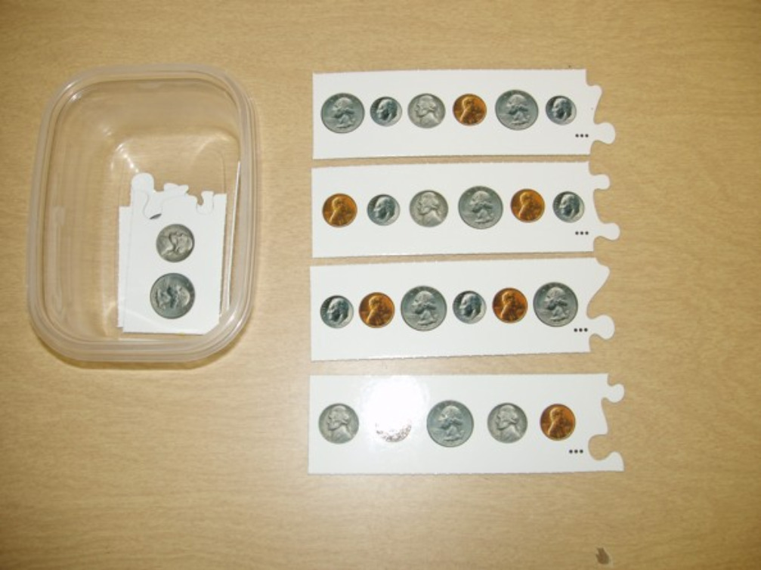
Steps for Task to Support the IEP Goal
Develop a structured teaching task for one of the choices: Match pictures of equivalent coin amounts.
Materials needed: coin puzzles; container for pieces; box to hold pieces and container; tape or hook and loop tape
Instructions:
Tape container to box on left side
Place small puzzle pieces in container
Hook & loop tape the larger pieces to the box on the right side of the container
Teach the task to the student

Slide 5
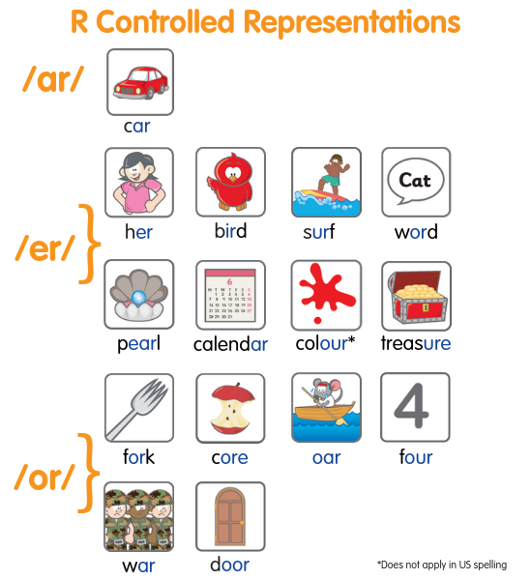
Steps for Grade Level Standard
Choose the standard: Complete the word with the right r-controlled vowel
Write steps to reach this standard:
  Orally blend and segment words (h-or-se)
  Teach ’r’ in charge with examples
  Use CVC words to teach pattern (can, cap, cat, car)
  Use rhyming words to teach (bar/car)
  Match pictures of r-controlled vowel words to ar, or, ur, ir

Slide 6
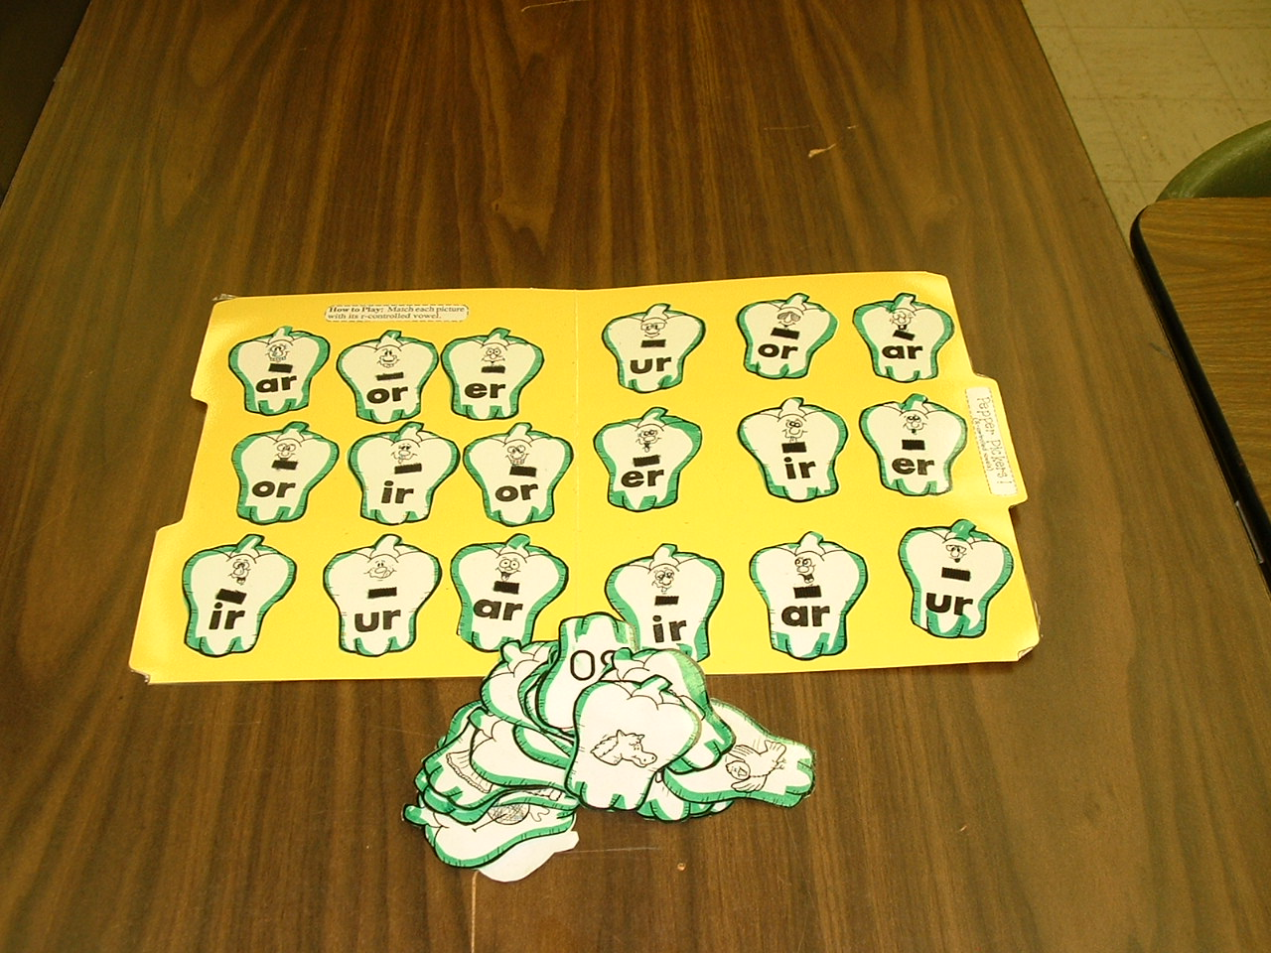
Steps for Task to Support Grade Level Standard Activity
Develop a structured teaching task to support one of the standards: Complete the word with the right r-controlled vowel
Materials needed: folder, cut up worksheet, lamination, glue stick, marker
Instructions:
Cut out r-controlled worksheet items
Highlight border of items
Glue r-controlled vowel items to folder
Glue closed envelope to back of folder
Laminate folder & matching items
Slit envelope to hold matching items
Add Velcro™ to folder, matching items, and envelope flap

Slide 7
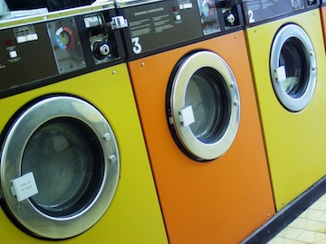
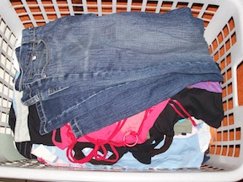
Steps for Task Analyzed Life Skill
Choose a task to be broken into steps: Put folded laundry away in dresser independently.
Write task analysis:
  Place folded clothing into an open container
  Open a drawer using a handle
  Match folded clothing item to a photo
  Place folded clothing into drawer with matching photo
  Close drawer

Slide 8
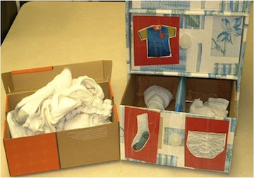
Steps for Task to Support the Task Analyzed Life Skill
Assess student on task analysis steps and develop a structured teaching task for that step: Place folded clothes into drawer with matching photo
Materials: clothing; drawers; photos
Instructions:
Print and laminate photos. Tape onto front of drawer and bottom of drawer.
Place folded clothing in box.
Teach how to complete task. May begin with one or two types of clothing and photos, and then add more items.

Slide 9
Remember:
Develop tasks based on assessed need. These should be specific for each individual.
Think about how the task can grow and change. Develop a plan for generalization.
Be sure the task has a purpose in the larger picture of learning/life and is not just busy work.
Teach the task at one-to-one sessions, adapting the task if data isn’t showing progress.

