Slide 1
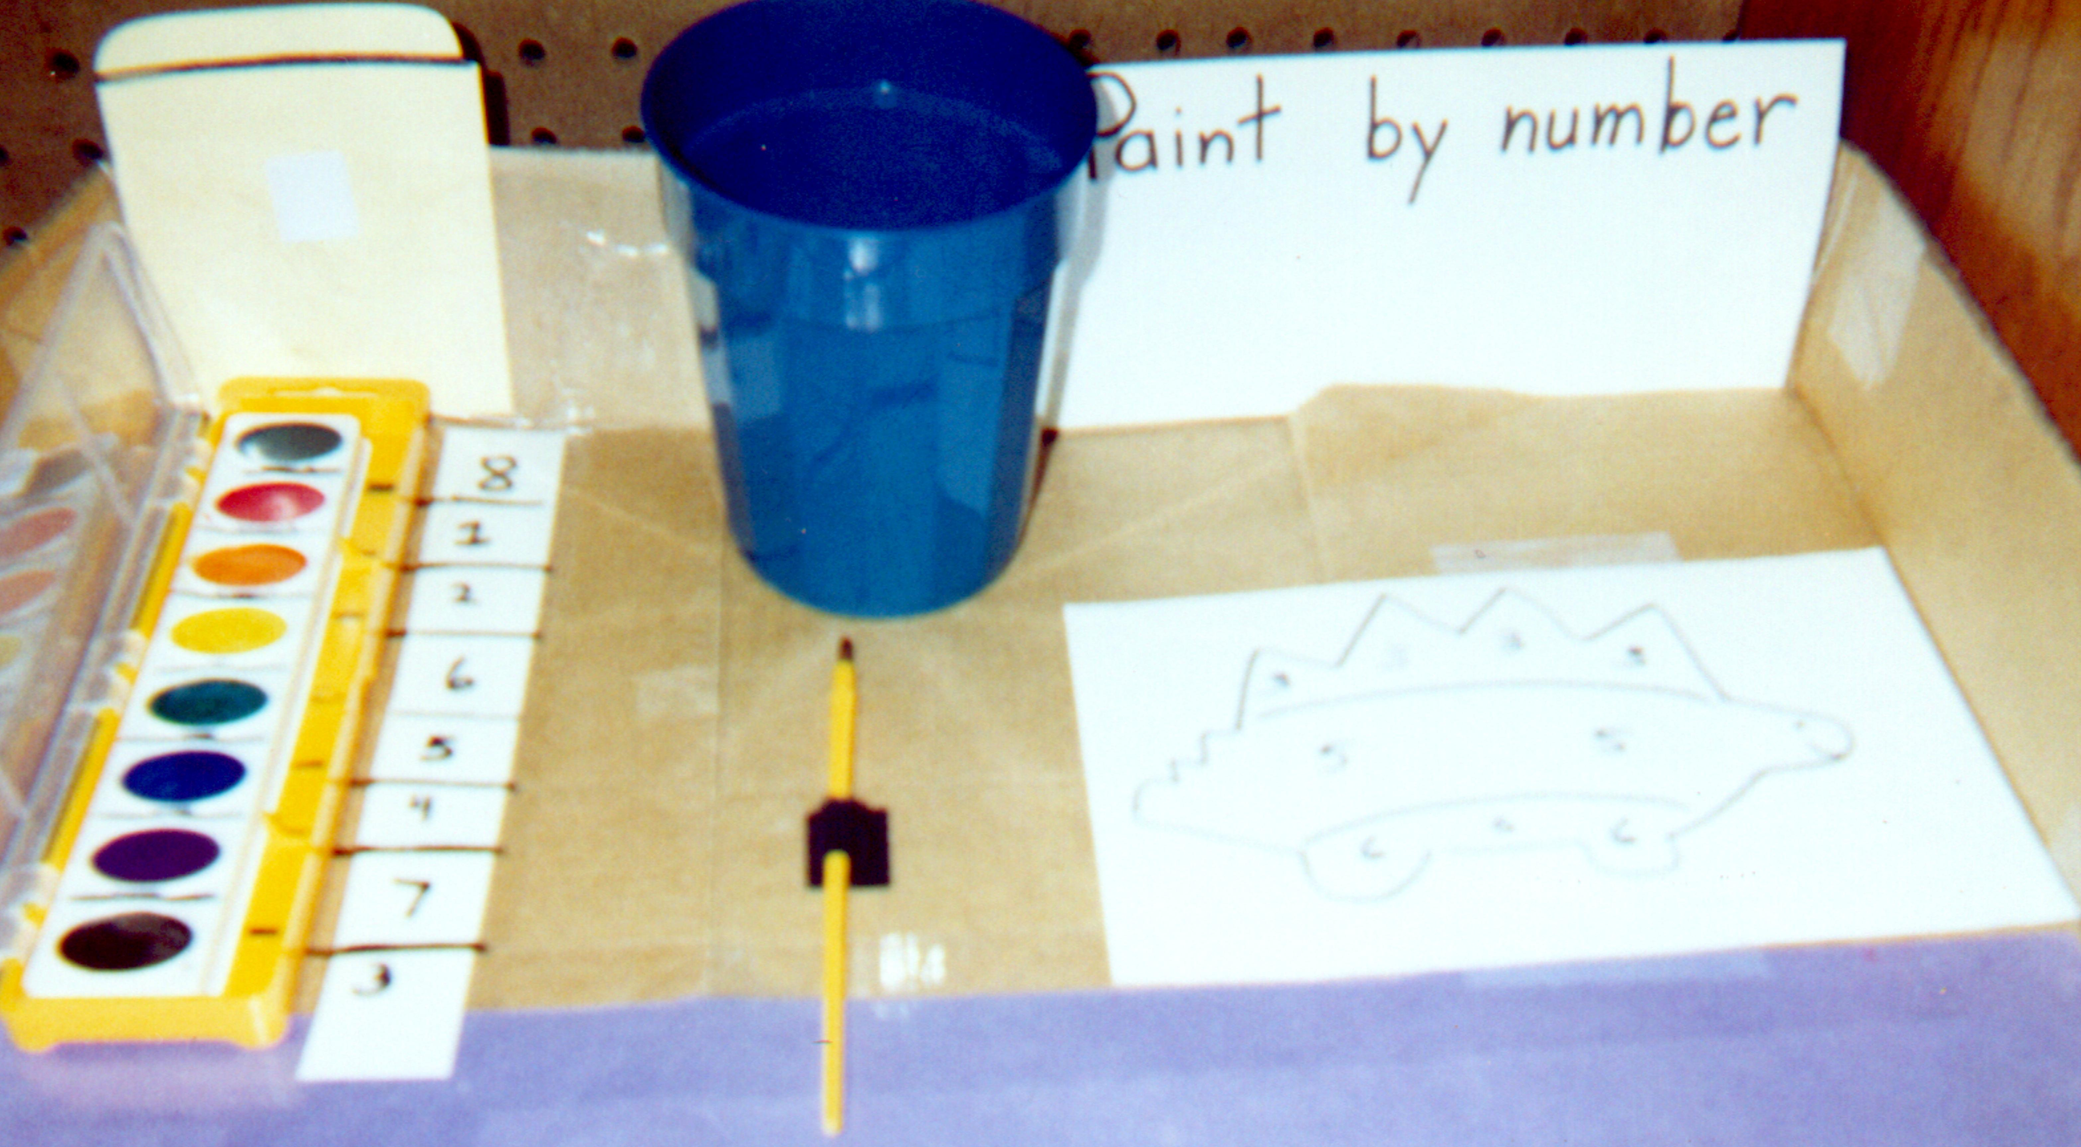
Task Examples
Samples of tasks that could be developed after individualized assessment.

Slide 2
Number a watercolor paint set. Number a line drawing. Paint by number.

Slide 3
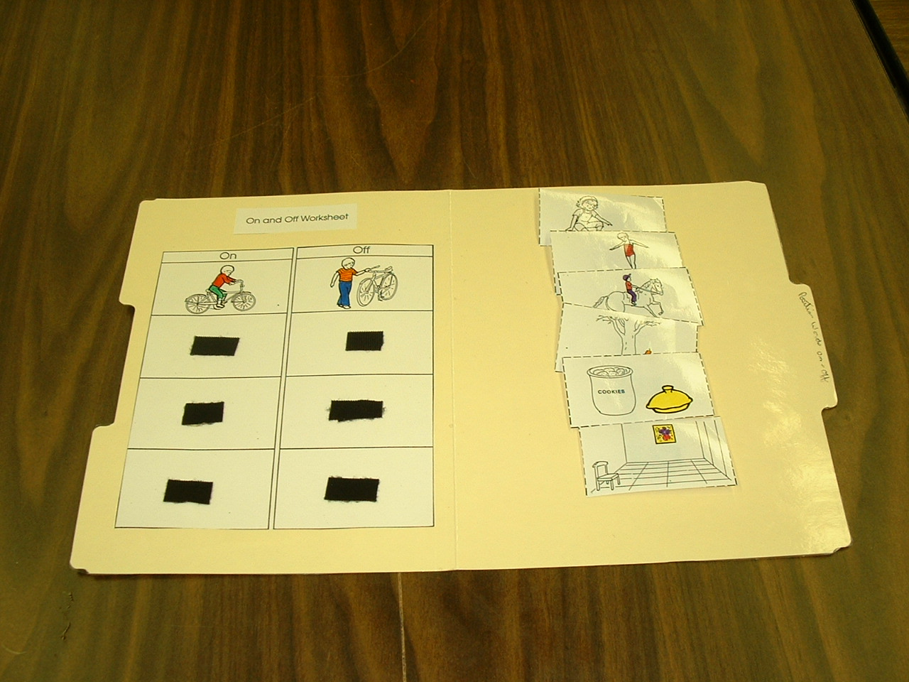
Cut out worksheet parts and laminate. Add hook and loop tape to categorize pictures as the position words on or off.

Slide 4
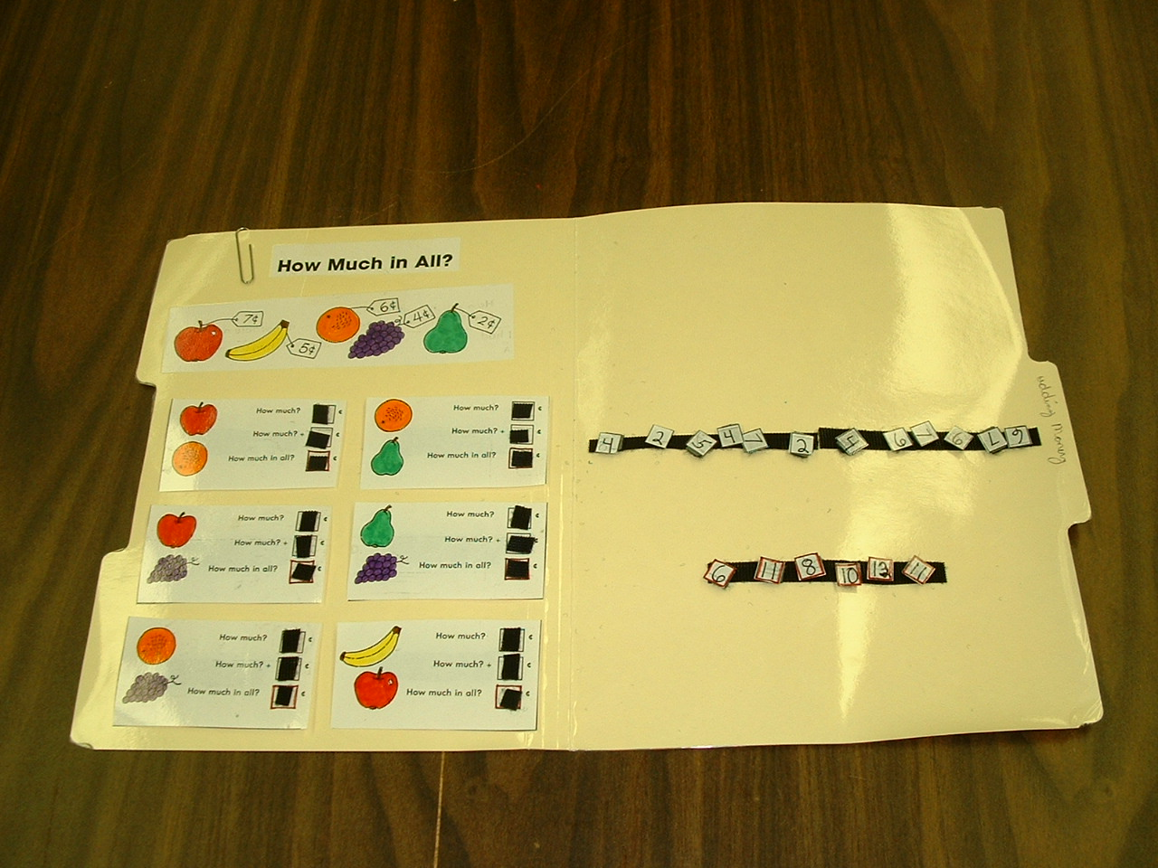
To complete math problems without writing, cut out and laminate worksheet parts. Add hook and loop tape to add answers to the problems.

Slide 5
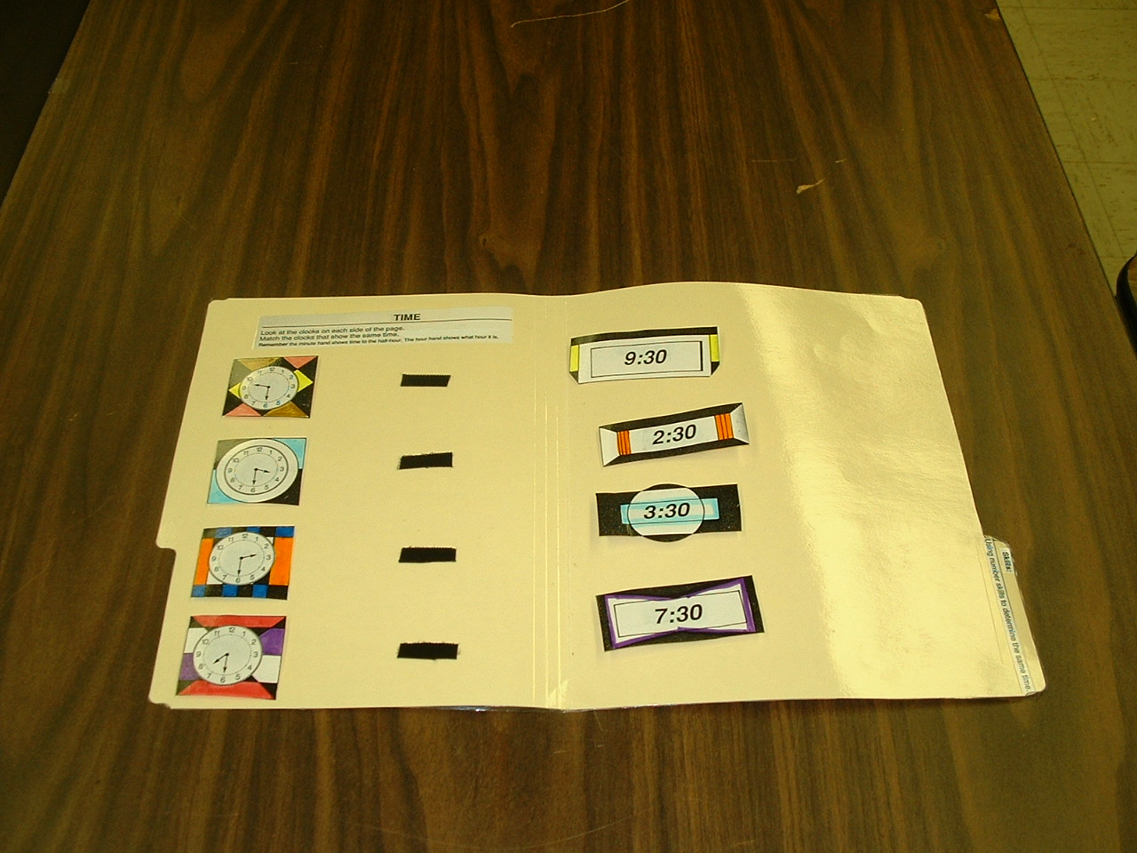
Color and cut out a clock worksheet. Add hook and loop tape to match times to the clocks.

Slide 6
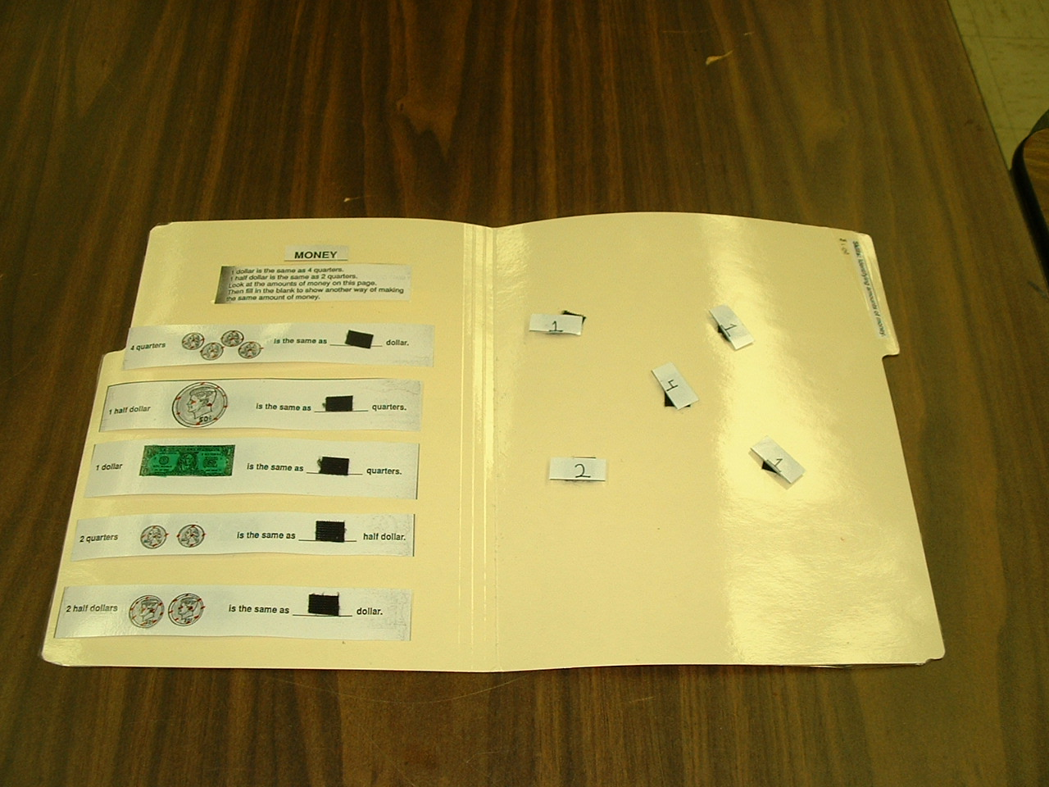
Color and cut out worksheet parts. Add hook and loop tape to match numbers in sentences about equivalent money amounts.

Slide 7
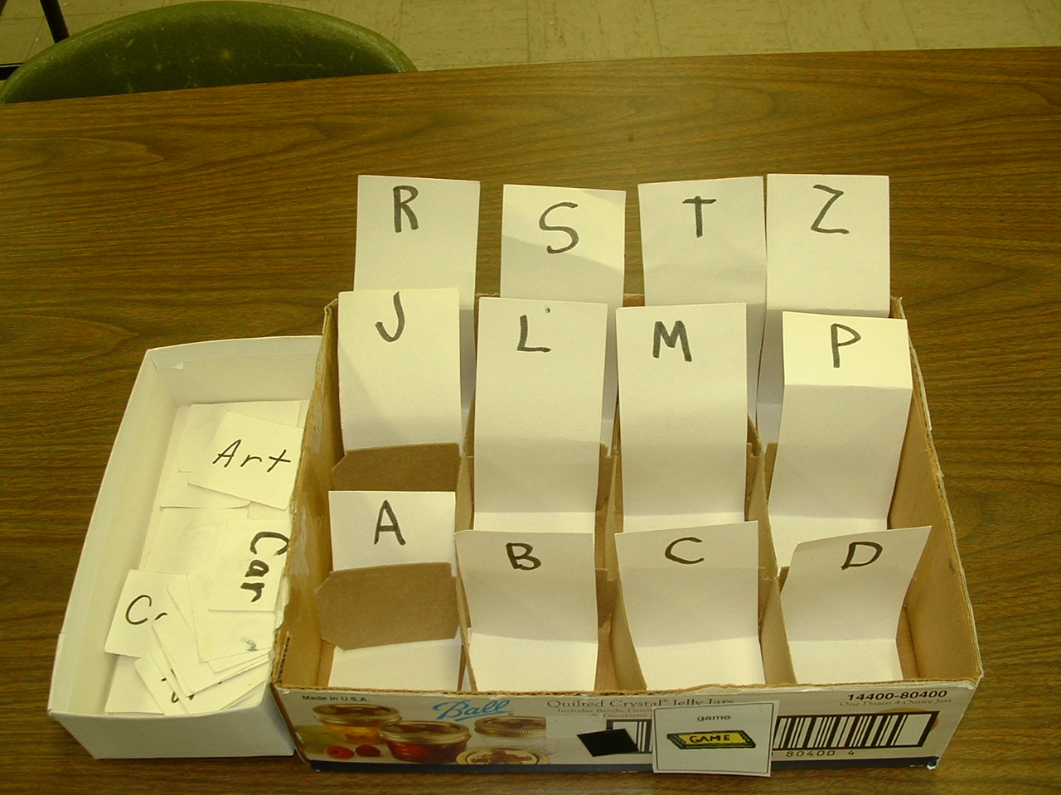
Beginning of alphabetical order: sort words by first letter

Slide 8
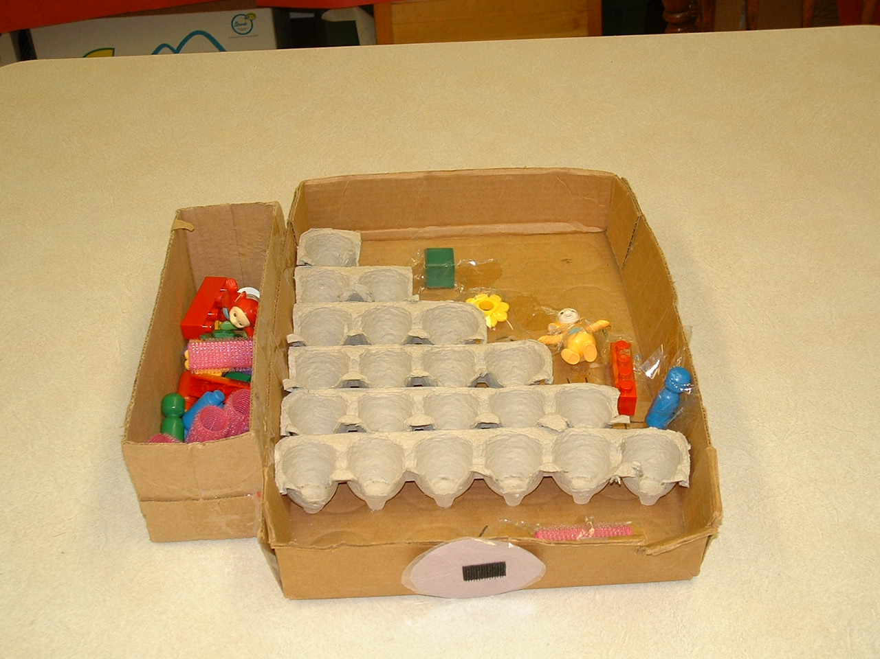
Beginning of quantity: place matching objects into egg containers for numbers 1-6

Slide 9
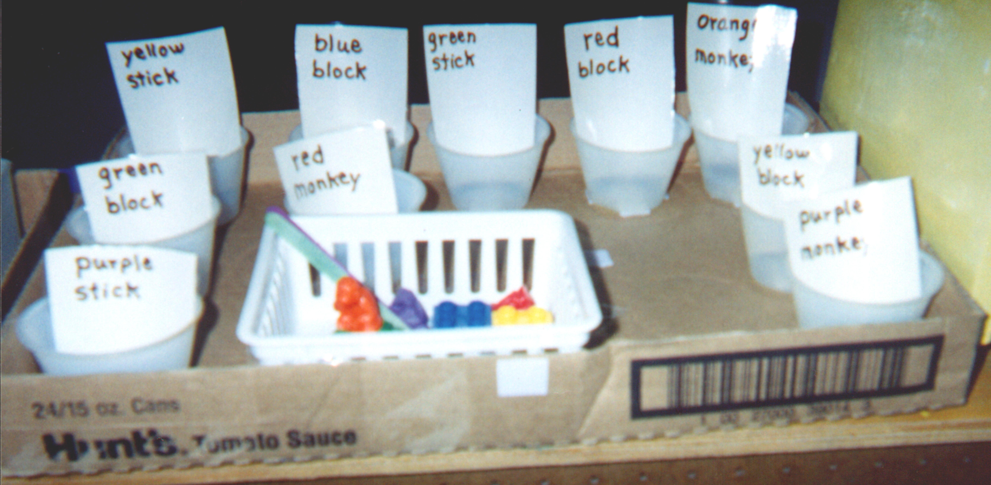
Reading: match object to written description

Slide 10
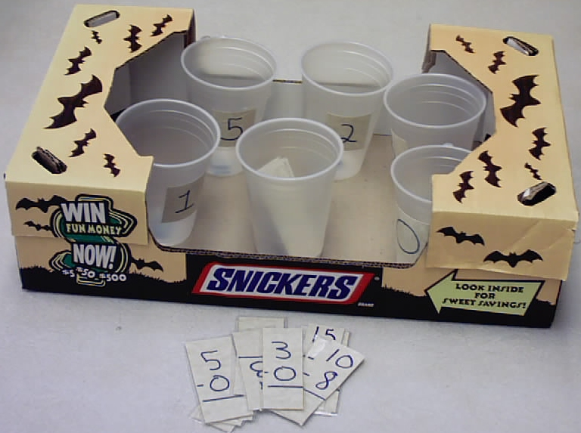
Sort math problems into cups with the correct answer

Slide 11
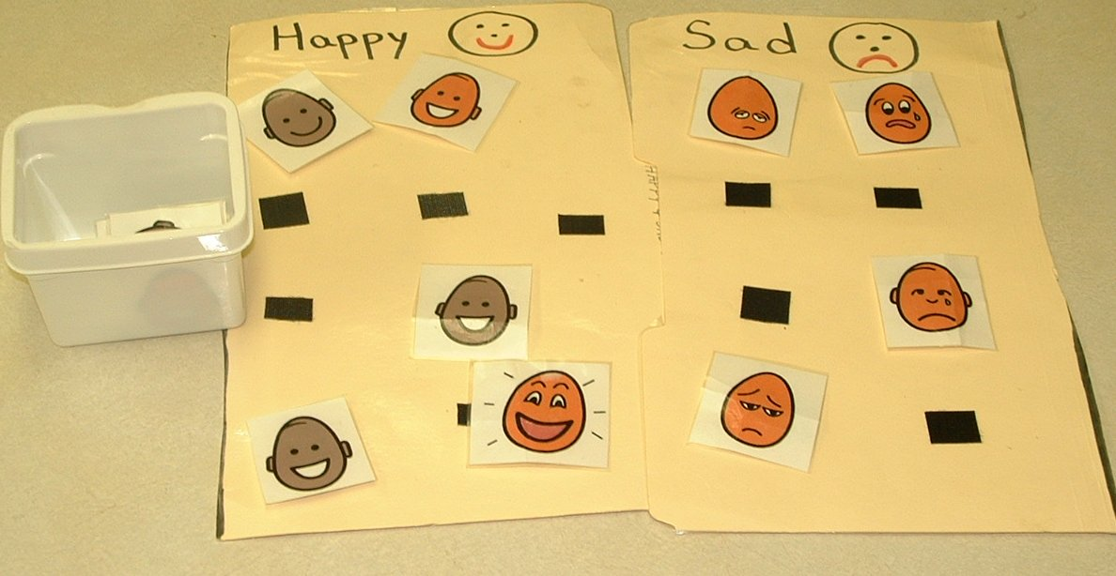
Emotions: match happy and sad pictures under words

Slide 12
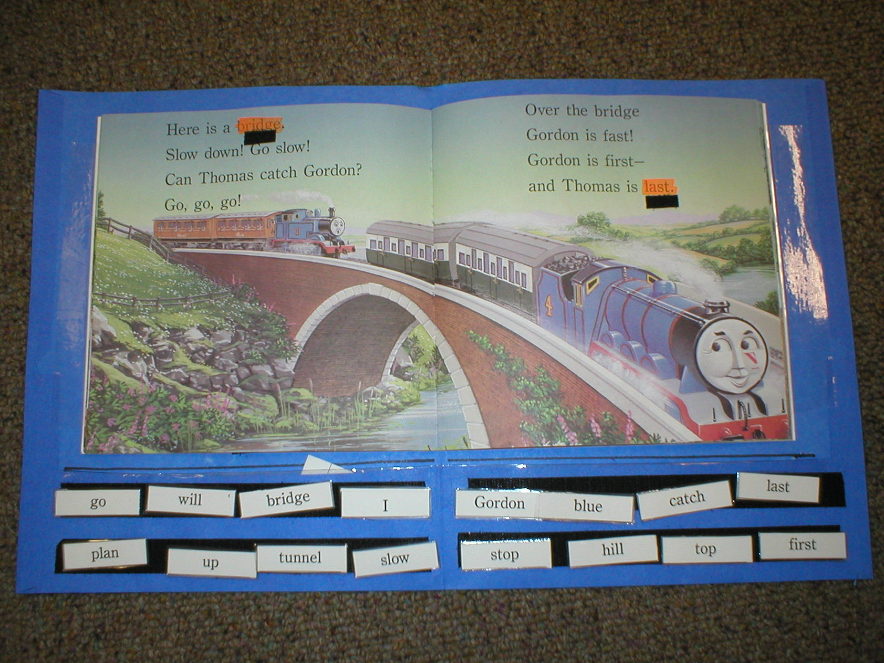
Type words from story. Highlight words. Add hook and loop tape to words. Match words to same in story.

Slide 13
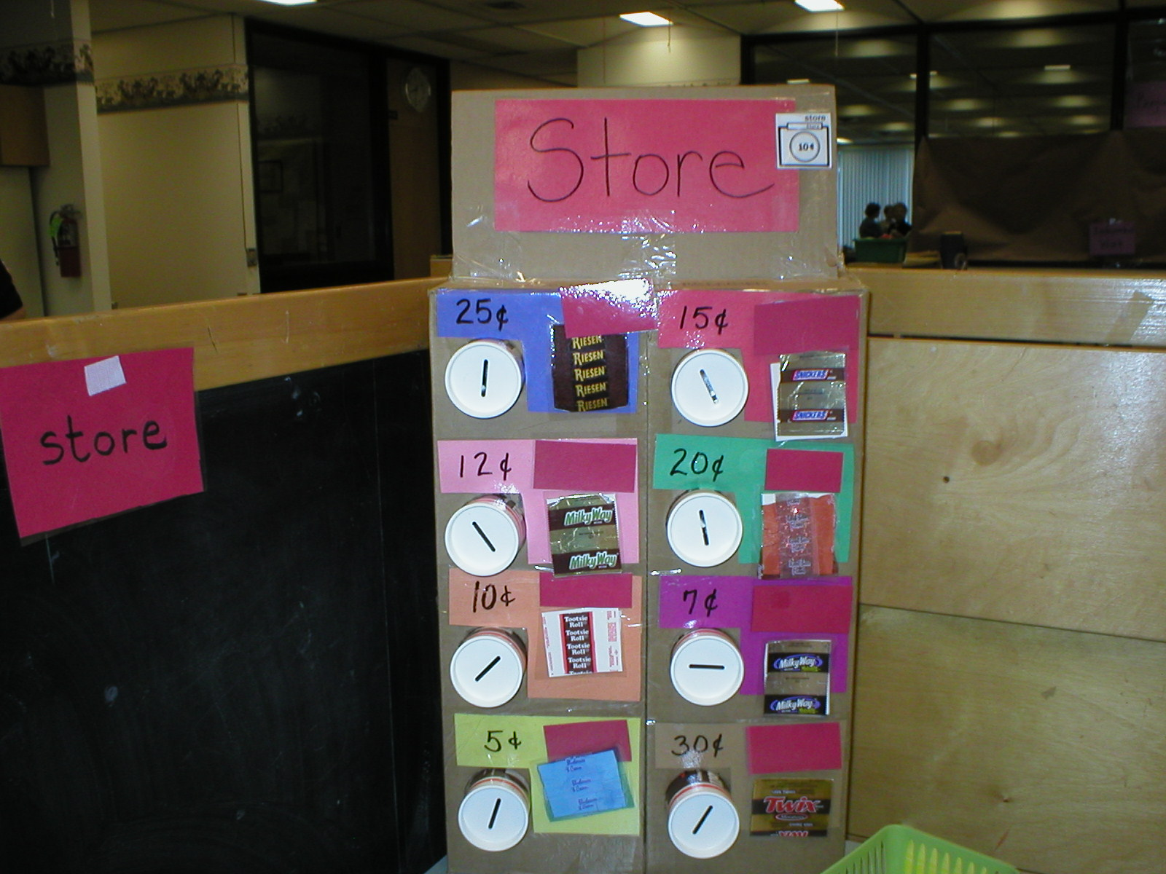
Purchase snack by placing correct amount of coins into “vending” machine

Slide 14
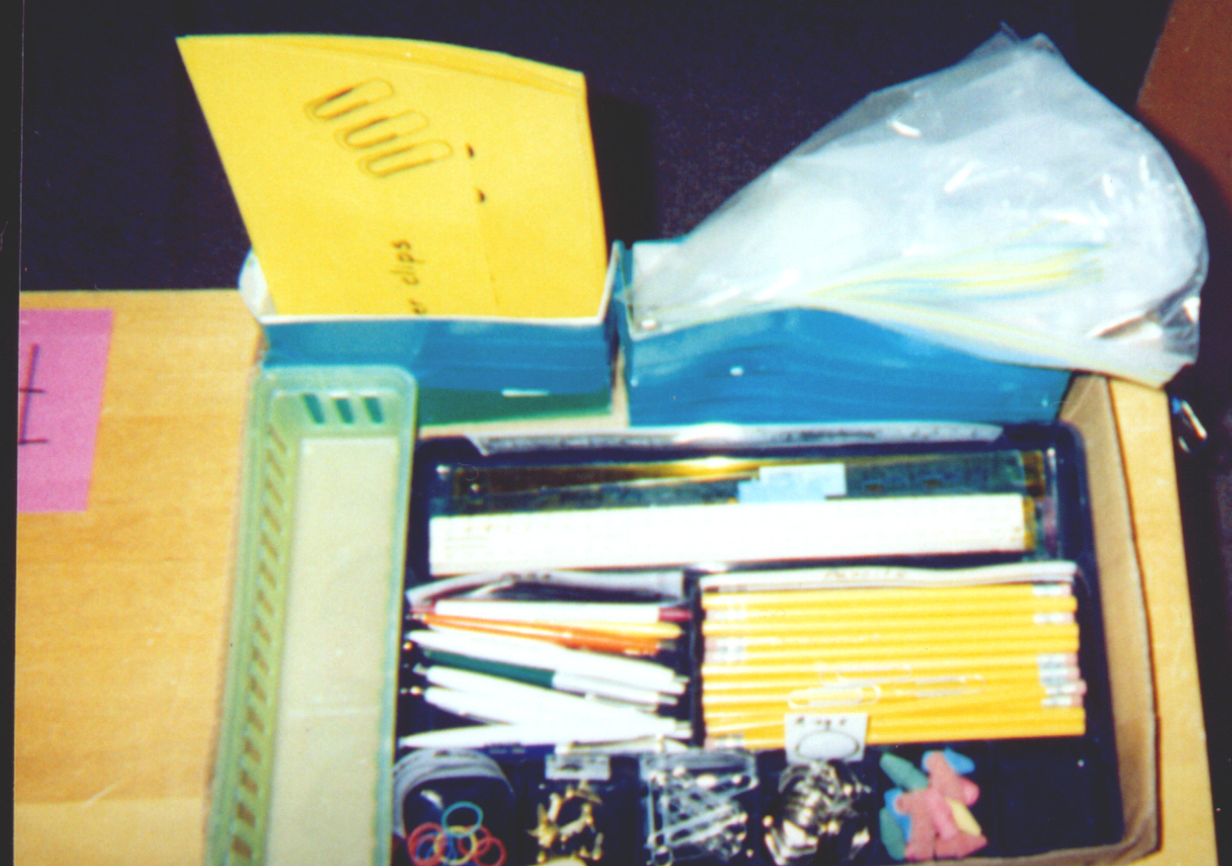
Assemble office materials following picture directions on each yellow sheet

Slide 15
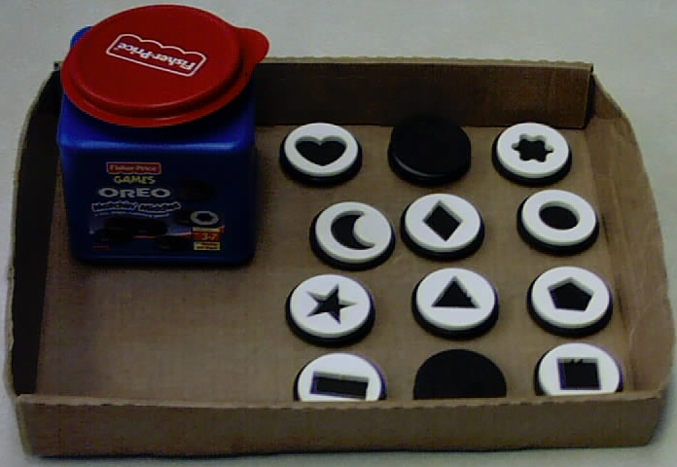
Structure game by securing game pieces to box and then matching other game piece

Slide 16
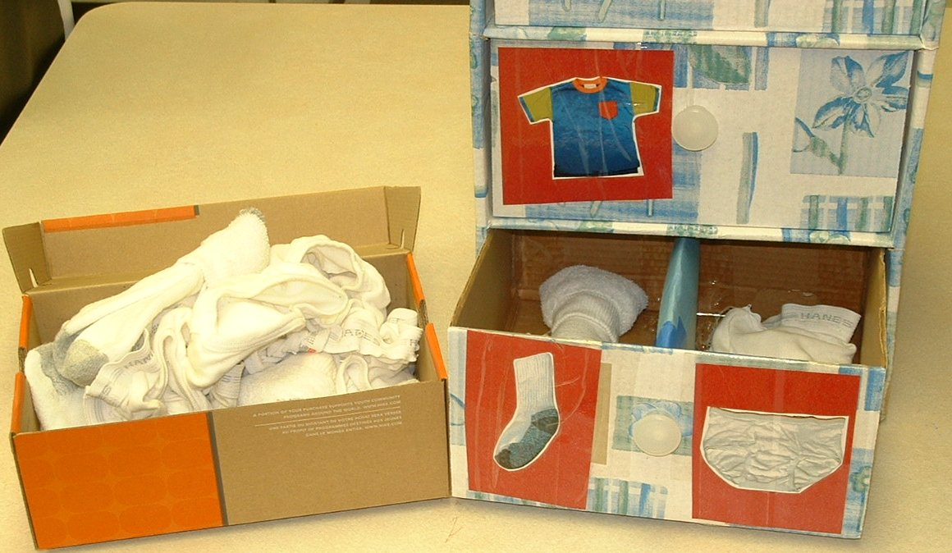
Sort clothing into drawers with photo cues and product sample

Slide 17
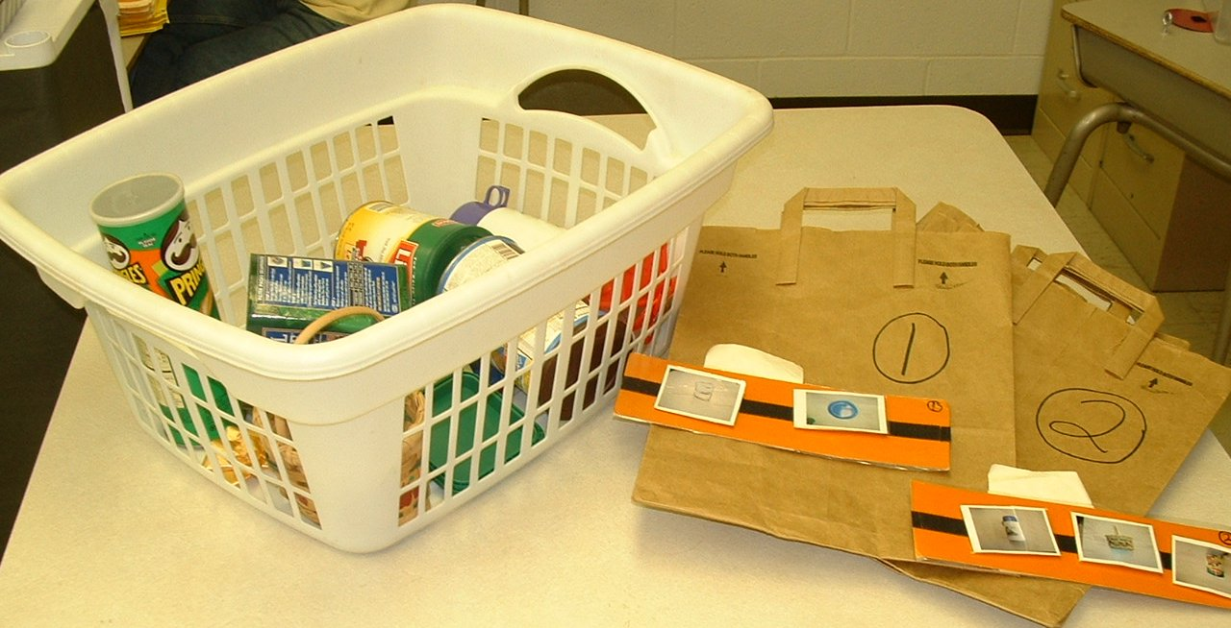
Practice shopping by matching photo list to numbered bag and then finding items on list from basket.

Slide 18
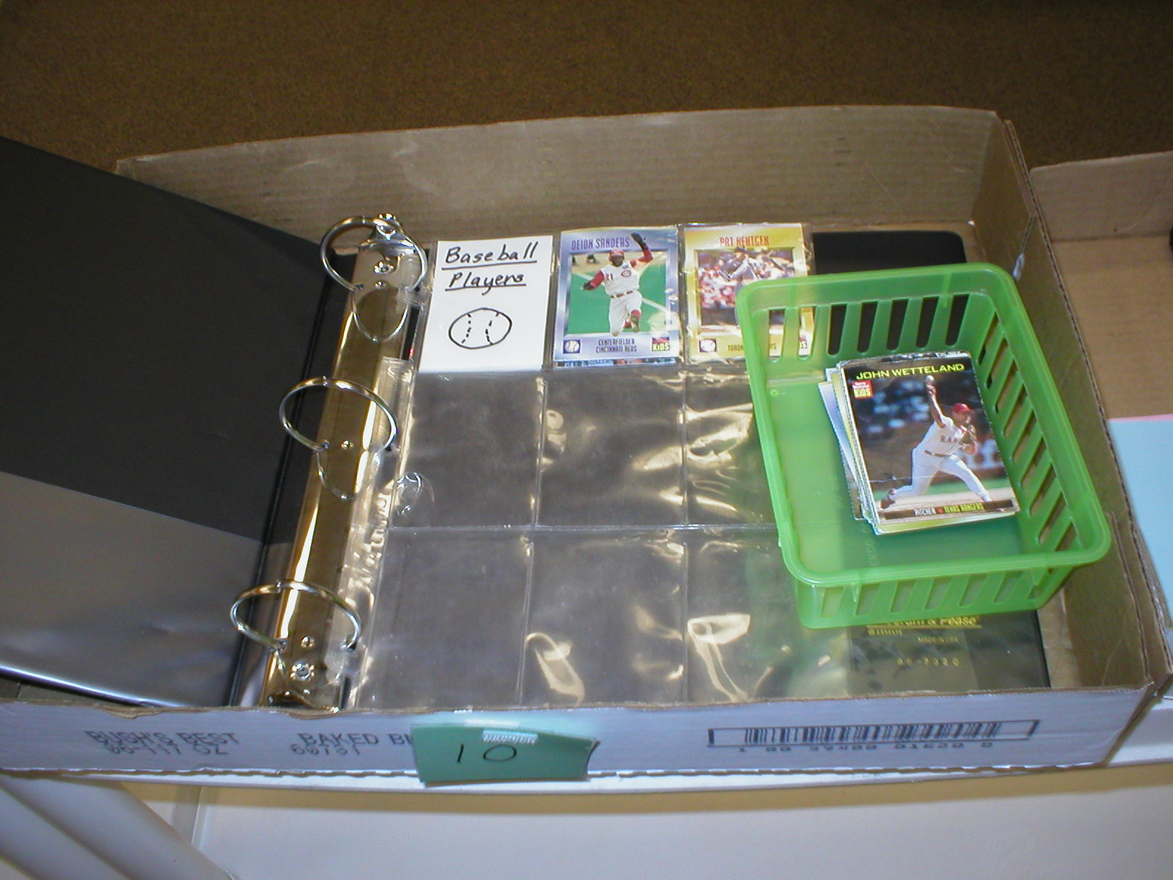
Sort sport cards by sport on indicated pages

Slide 19
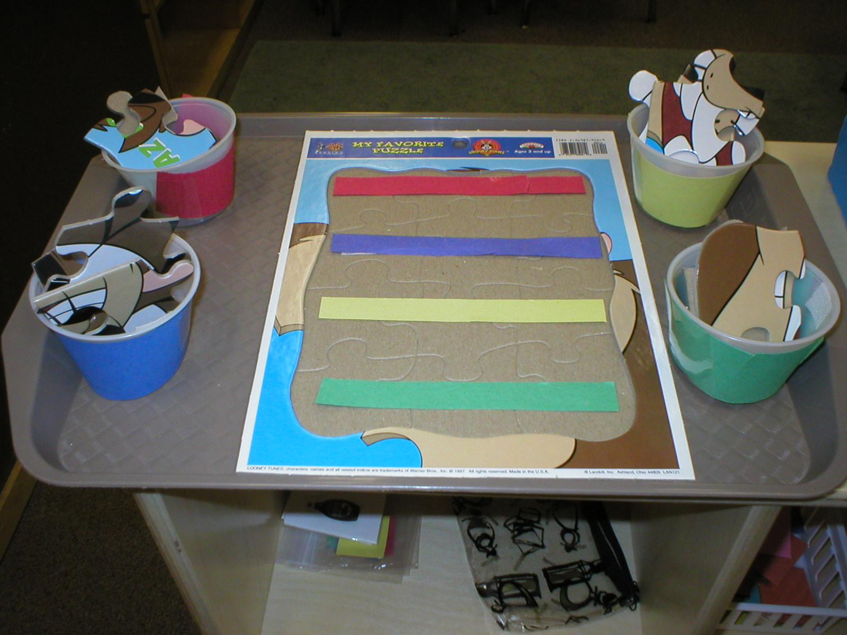
Assemble puzzle a row at a time with puzzle pieces sorted by row in color cued cups

Slide 20
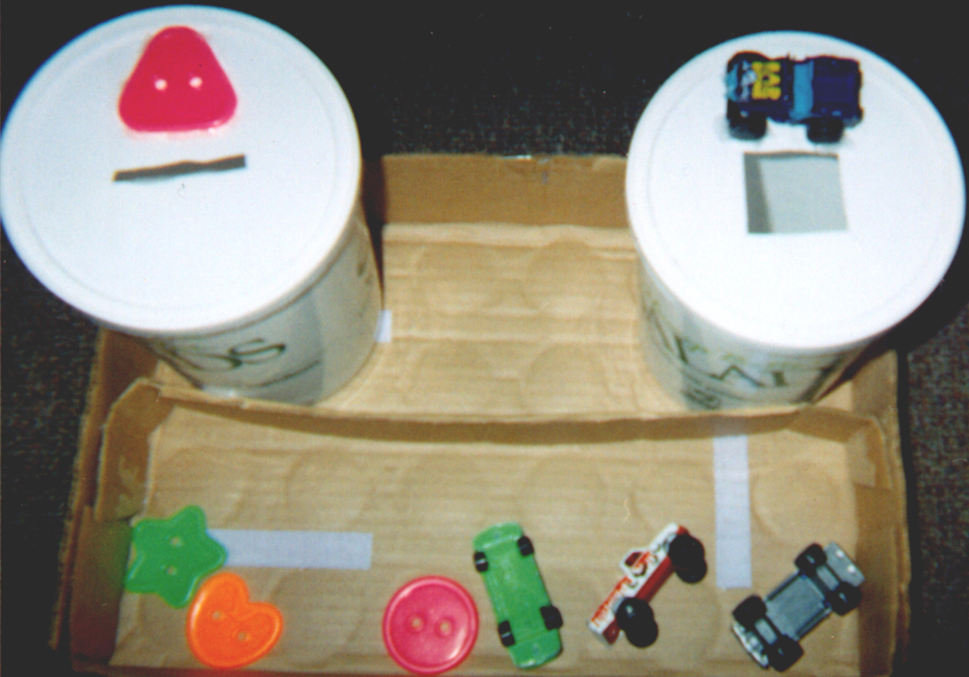
Sort objects given visual cue in container lid and product sample

Slide 21
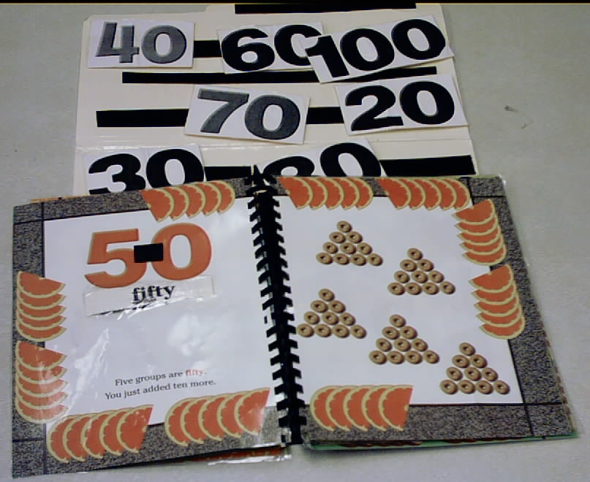
Match number and number word to same in laminated book

Slide 22
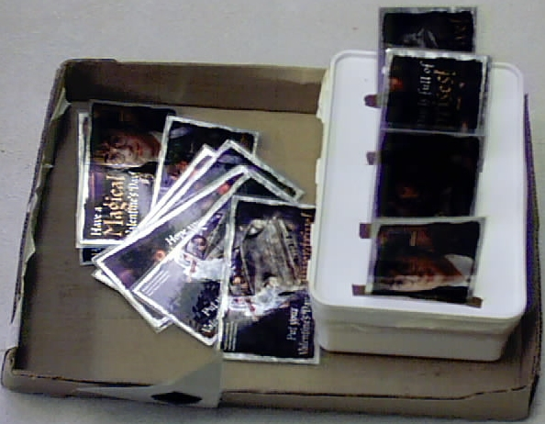
Sort laminated Valentine cards of high interest area with lots of detail

Slide 23
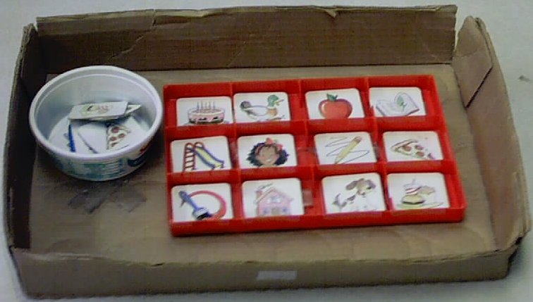
Match cards to same picture in tray

Slide 24
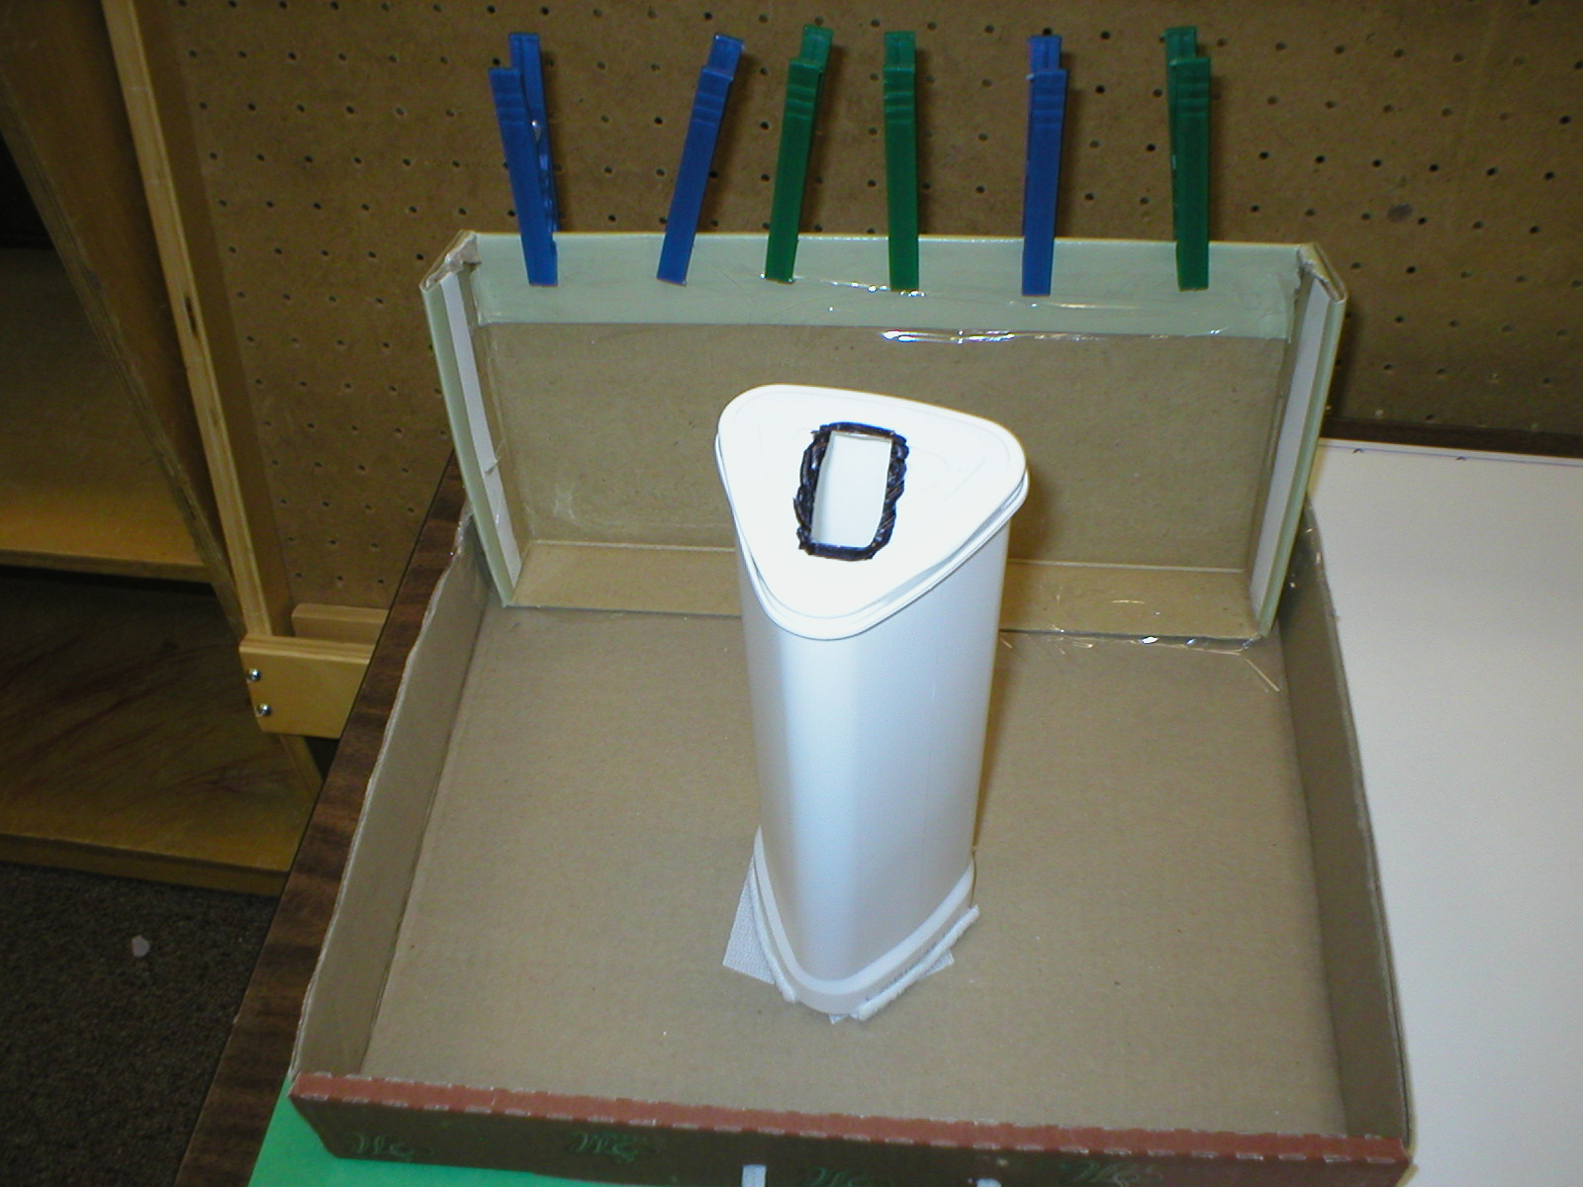
Clothespins into container

